Slide 1
Smartwatch Sentiment Analyzer
Uncovering Customer Sentiments using Streamlit and TextBlob
Presented by Group 9
M. Vashisht Raghav-AP23110010998
S.Sai Charan Reddy -AP23110010432
J.Hari Charan-AP23110010486
V.Abhiram-AP23110010988
A.Nitish -AP23110010102
SRM University, 2025
Guided by Aravind Reddy

Slide 2

Introduction: The Power of Customer Feedback
Customer Feedback is Paramount
Sentiment Analysis Unlocks Insights
Understanding customer opinions is crucial for product evolution and market success.
It provides a systematic approach to gauge user feelings and attitudes from text data.
Automated Review Analysis
Focus: ABC X1 Smartwatch
The increasing volume of online reviews necessitates automated tools for efficient processing.
We apply these principles to reviews of the ABC X1 Smartwatch to demonstrate practical application.

Slide 3

Problem Statement: The Challenge of Manual Review Analysis
Manual analysis of customer feedback presents significant hurdles for businesses seeking to understand user sentiment.
Time-Consuming Process
Manually sifting through thousands of reviews is inefficient and prone to human error.
Difficulty in Gauging Satisfaction
Extracting overall sentiment and identifying key themes is challenging without automated tools.
Need for Real-Time Insights
Businesses require immediate feedback to respond quickly to customer concerns and market trends.
Automated Smartwatch Review Analysis
Our objective is to streamline the analysis of smartwatch reviews, providing actionable insights automatically.

Slide 4
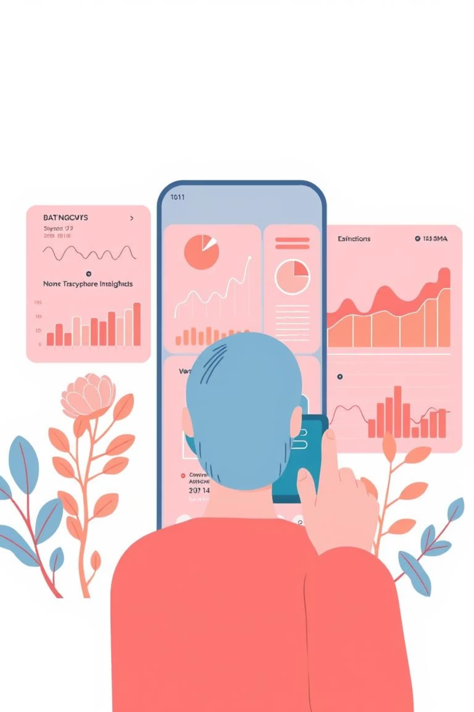

Project Objectives: Building an Intuitive Sentiment Tool
User-Friendly Tool Development
To create an accessible and intuitive sentiment analysis application.
Sentiment Classification
To accurately categorize reviews into Positive, Negative, or Neutral sentiments.
Instant Customer Feedback
To enable companies to grasp customer sentiment quickly and effectively.
Informed Product Decisions
To provide data-driven insights that support continuous product improvement.

Slide 5


Core Technologies Utilized
Our project leverages a combination of powerful and accessible technologies to deliver a robust sentiment analysis solution.
Python
Streamlit
The foundational programming language for backend logic and data processing.
Used for building a simple, elegant, and interactive web-based user interface.
TextBlob
Development Environment
A Python library for natural language processing, crucial for sentiment analysis.
Command Prompt or Python IDE for coding, testing, and execution.

Slide 6





System Architecture: From Input to Insight
User Input
Users enter smartwatch reviews into the system.
Streamlit Web Interface
Accepts and displays user input, creating an interactive experience.
TextBlob Analysis
Processes the text for sentiment polarity and subjectivity.
Sentiment Classification
Categorizes the review as Positive, Negative, or Neutral.
Instant Result Display
Shows the sentiment classification and polarity score immediately.

Slide 7

Project Workflow: A Step-by-Step Process
The sentiment analyzer follows a clear and efficient process to convert raw text into actionable sentiment data.
Review Entry
User inputs the smartwatch review text into the application.
Input Validation
The system checks the input for proper formatting and content suitability.
NLP Sentiment Analysis
TextBlob's Natural Language Processing capabilities are employed to understand the text's emotional tone.
Polarity & Subjectivity Calculation
The system quantifies the emotional charge (polarity) and factual basis (subjectivity) of the review.
Final Sentiment Display
The categorized sentiment (Positive, Negative, Neutral) along with scores is presented to the user.
Review History Storage
All analyzed reviews and their results are stored for future reference and trend analysis.

Slide 8
Future Enhancements: Evolving the Analyzer
E-commerce Integration
Advanced ML & Deep Learning
Multilingual Support
Expand capabilities to analyze reviews in multiple languages.
Directly pull reviews from online retail platforms for automated analysis.
Incorporate sophisticated models for higher accuracy and nuanced sentiment detection.
Enhanced Analytics Dashboard
Mobile Application Version
Provide comprehensive visual summaries and trend analysis of sentiment data.
Develop a dedicated mobile app for on-the-go sentiment analysis.

Slide 9
Conclusion: A Step Towards Data-Driven Product Development
1
Successful Implementation
The Smartwatch Sentiment Analyzer is a fully functional, real-time system.
2
User-Friendly & Effective
It offers an intuitive interface that delivers accurate sentiment insights efficiently.
3
Empowering Businesses
Companies can now easily analyze customer feedback, fostering better relationships and product strategy.
4
Driving Product Improvement
The tool provides critical data for informed decision-making and continuous product enhancement.
5
NLP in Real-World Scenarios
This project effectively demonstrates the practical application of Natural Language Processing in a business context.

